Slide 2
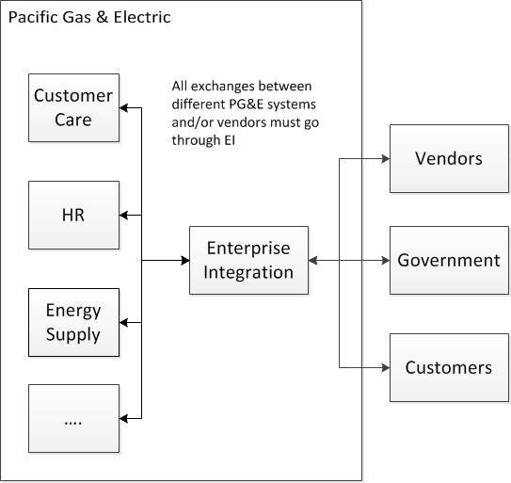
What is Enterprise Integration?
Build interfaces that connect to other department’s applications
Eg. Build an interface that let’s mobile apps call SharePoint API
Millions of transactions per day
Hundreds of new services built every year
Notes:
I work at Pacific Gas & Electric in the Enterprise Integration group, which is a part of the IT department. EI acts as a hub for data transactions between all other PG&E departments and vendors working with PG&E. For example, if Energy Supply wants to build a mobile app that lets their workers get files from the company SharePoint site, they will ask EI to build a web service that connects their mobile apps to the SharePoint API. Or if HR uses an external vendor to manage employee benefits, they will need an EI service to transfer the necessary employee information to the vendor.
So as you can imagine, EI processes a lot of data. We have millions of transactions a day across many different departments and technologies. This

Slide 3
Challenge 1: How capture logs?
Sample Log 1: 10 possible fields
Sample Log 2: 30 possible fields
{"Type":"AUDIT","InterfaceName":"HourAheadResourceFinalScheduleUpdate_proxy","SourceName":"FBS- GOLAsourceinfo","ServerID":"itapposbdev01.comp.pge.com.ITAPPOSBD01MS2","ThreadID":"66","AuditName":"HourAheadResourceFinalScheduleUpdate_proxy_Response","AuditMessage":"Outgoing message from EI to FBS for DayAheadAncillary","InboundMessage":“ <ns0:sendResourceHAScheduleResponse><ns1:scheduleFinalResourceHourAheadSendV1Response><ns1:systemMessage><ns2:systemMessageCode>0<\/ns2:systemMessageCode><ns2:systemMessageDescription>Success<\/ns2:systemMessageDescription><\/ns1:systemMessage><\/ns1:scheduleFinalResourceHourAheadSendV1Response><\/ns0:sendResourceHAScheduleResponse>","CustomValue1":"Auditing the Outgoing request to FBS for DayAheadAncillary"}
16 Sep 2015 14:35:15,688 WARN correctiveaction: {"Type":"AUDIT","InterfaceName":"CreateNotification_proxy","SourceName":"Phone","TrackingID":“J2P21442285293971","ServerID":"itapposbdev01.comp.pge.com.ITAPPOSBD01MS1","ThreadID":"35","AuditName":"CreateNotification_proxy_RequestPayload","AuditMessage":"CreateNotification Request JSON Payload","InboundMessage":"{\"Header\":{\"Verb\":\"create\",\"Noun\":\"Notification\",\"Revision\":\"2.0\",\"Timestamp\":\"2015-09-15T02:48:14.333Z\",\"Source\":\"Phone\",\"User\":{\"UserID\":\“J2P2\",\"Organization\":\"PGE\"},\"MessageID\":\“J2P21442285293971\"},\"Payload\":{\"Notification\":{\"Title\":\"Testing gas 123\",\"Description\":\"Testing gas 123\",\"NotificationType\":\"GA\",\"WorkTypeMainCategory\":\"\",\"WorkTypeSubCategory\":\"\",\"AssetFamily\":\"\",\"Process\":\"PRDA\",\"Division\":\"\",\"CloseCall\":\"\",\"Longitude\":\"\",\"Latitude\":\"\",\"Anonymous\":\"true\",\"AttachmentList\":null}}}","CustomValue1":“J2P2"}
Notes:
Like any good computer code should, all of these web services generate error, audit, and performance logs. But since we have so many different web services touching many different domains. The challenge is “How can we store these logs in a way that captures the important information?”
Currently, we are using a database with a table for each log type. So for example we have a table for performance logs, a table for audit logs, and so on. Here’s the issue: Our audit logs in particular capture different types of information. And the important fields in one web service’s logs might not even be present in another web service’s logs. So what columns are you going to have in your table? For example, look at the following two logs in this slide.
These are both audit logs from our dev environment from two of our web services in our test environment. Although they share the same basic structure, having a Type, Name, Source, and Message, the log on the right has many more text strings that one could consider fields. If you try to store both these logs in the same table, you’ll either miss a lot of the information in the second log and/or have a lot of empty columns for the first log.
There’s not really a good “one-size fits all schema” that we can use.

Slide 4
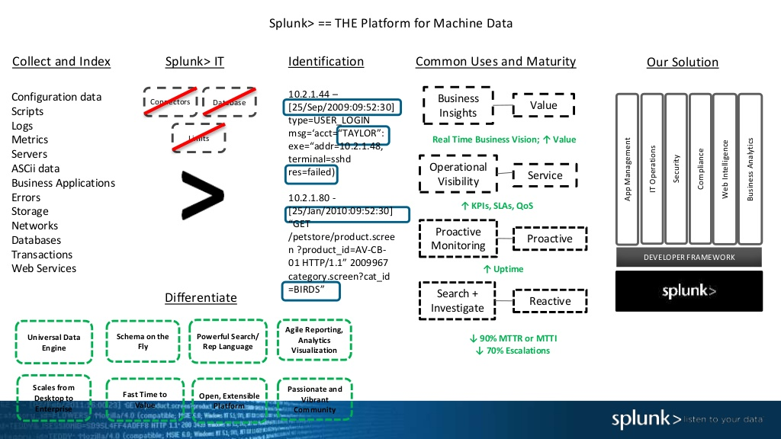
Notes:
The answer is a tool like Splunk Enterprise, or just Splunk, which is a platform for storing and analyzing machine data like logs. Splunk stores log data in its raw form as events, and then applies extracts fields from the raw log data on read. It’s kind of like schema-on-read, except that Splunk doesn’t apply a schema and instead tries to parse and extract as many fields as it can find from each event. This type of processing might sound like a hassle, but Splunk use its own proprietary implementation of MapReduce to process, cache, and serve data in seconds.
Slides from http://www.slideshare.net/Splunk/getting-started-with-splunk-enterprises-56060012

Slide 5
More than just logs…
Data we know how to handle
Notes:
Installing Splunk was actually very easy, and within a couple of hours, we had setup Splunk to monitor all the logs in one of our dev domains.
So what happened is that the Splunk invited us all on this web conference where we could see him scroll through all our newly indexed Splunk log data. And one of the things she kept saying ws “Ask me any question about your data.”
I remember one of the first questions was “How many errors are there for each web service?”, and the Splunk representative wrote in a

Slide 6
Challenge 2: What do we do with other stuff?
Sample System Logs
Sample Access Log
<Oct 1, 2015 12:22:41 PM PDT> <Warning> <Socket> <BEA-000449> <Closing socket as no data read from it on 10.60.0.90:53,778 during the configured idle timeout of 25 secs>
<Oct 1, 2015 12:22:41 PM PDT> <Warning> <Socket> <BEA-000449> <Closing socket as no data read from it on 10.60.0.90:53,769 during the configured idle timeout of 25 secs>
<Oct 1, 2015 12:23:14 PM PDT> <Notice> <LoggingService> <BEA-320400> <The log file /logs/weblogic/domains/ITAPPOSBD01/logs/ITAPPOSBD01.log will be rotated. Reopen the log file if tailing has stopped. This can happen on some platforms like Windows.>
<Oct 1, 2015 12:23:14 PM PDT> <Notice> <LoggingService> <BEA-320401> <The log file has been rotated to /logs/weblogic/domains/ITAPPOSBD01/logs/ITAPPOSBD01.log48091. Log messages will continue to be logged in /logs/weblogic/domains/ITAPPOSBD01/logs/ITAPPOSBD01.log.>
<Oct 1, 2015 1:07:19 PM PDT> <Error> <ALSB Console> <BEA-494002> <Internal error occured in OSBConsole : null
java.lang.reflect.InvocationTargetException
at sun.reflect.NativeMethodAccessorImpl.invoke0(Native Method)
at sun.reflect.NativeMethodAccessorImpl.invoke(NativeMethodAcc..
…..
10.60.186.13 2015-10-03 16:58:37 0.0020 GET /helloworld/ 200 67
10.60.186.12 2015-10-03 16:58:39 0.0020 GET /helloworld/ 200 67
10.60.186.12 2015-10-03 16:58:39 0.0010 GET /helloworld/ 200 67
10.60.186.13 2015-10-03 16:58:42 0.0030 GET /helloworld/ 200 67
10.60.186.13 2015-10-03 16:58:42 0.0010 GET /helloworld/ 200 67
10.60.186.12 2015-10-03 16:58:44 0.0010 GET /helloworld/ 200 67
10.60.186.12 2015-10-03 16:58:44 0.0010 GET /helloworld/ 200 67
10.60.186.13 2015-10-03 16:58:47 0.0010 GET /helloworld/ 200 67
10.60.186.13 2015-10-03 16:58:47 0.0020 GET /helloworld/ 200 67
10.60.186.12 2015-10-03 16:58:49 0.0030 GET /helloworld/ 200 67
Notes:
So now the second challenge is what should we do with all this other machine data. In a way it’s kind of the opposite of our first challenge: In the first challenge, we knew what to use them for, but we didn’t know how to store them. In the second challenge, we know how to store this machine data, but we’re not sure how to use th

Slide 7
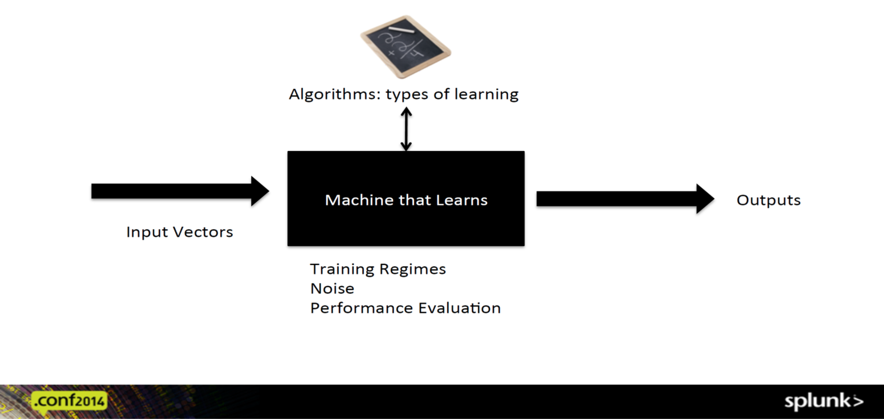
What is Machine Learning?
Notes:
By the way, I promise this is the last slide I steal from Splunk.
Slide from https://conf.splunk.com/session/2014/conf2014_FredWilmotSebastienTricaud_Security.pdf

Slide 8
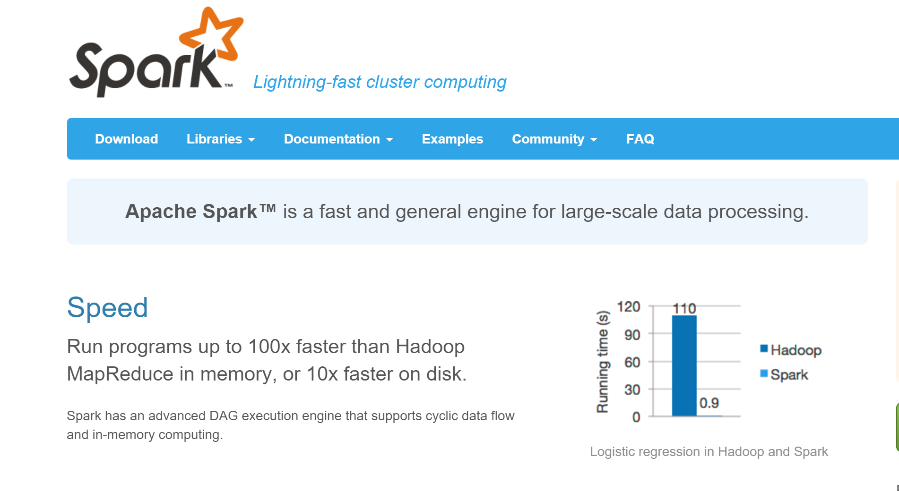
Notes:
This brings us to Apache Spark. This is a screenshot of the top part of the home page spark.apache.org website as of December 10th 2015. It’s basically the first thing someone will see. I think this website does a pretty good job summarizing what Spark is: As you can see, here are the two things you need to know about Spark
1. Apache Spark is a fast and general engine for large-scale data processing
2. Spark runs programs up to 100x faster than Hadoop MapReduce, and you can see that in that chart on the right that you got Hadoop running logistic regression in 110 seconds while Spark does it in less than a second.
These are impressive claims, but do they actually hold up in the real world? I’m thinking that Splunk might not be Hadoop, but Splunk still uses a form of MapReduce. And 100x faster is a pretty big margin, so even if Splunk MapReduce is not exactly the same as Hadoop MapReduce, we should still see at least a somewhat signfiant difference in speed when comparing Splunk MapReduce to Spark. At least when performing Logistic regression as displayed on the chart on the right.
Page from apache.spark.com

Slide 9
A Fair (as possible) Comparison
Notes:
Now let’s think about how we can test whether Spark is actually 100 times faster than Splunk. They are two very different types of systems. Splunk has a user interface, Spark is code only. Splunk
Splunk machine learning
Only want to compare performance of algorithm
Spark
Splunk forwarding
Modify to Splunk ML App to call Spark algorithm instead of Splunk algorithm
Same machine
Splunk will clean data, pass to Splunk, Spark alogirthm

